Slide 1
Computational Chemistry
Lecture 3: Hartree-Fock equation and Hartree-Fock-Slater model

Slide 2
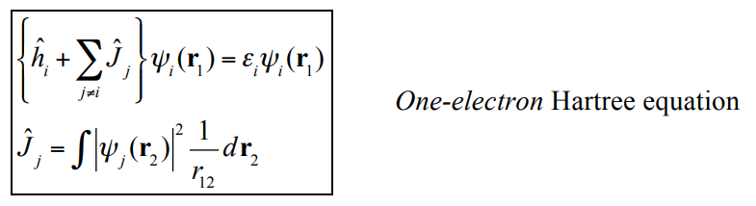
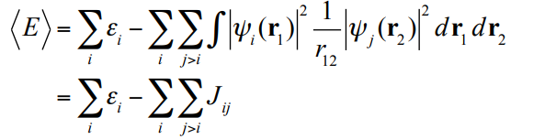
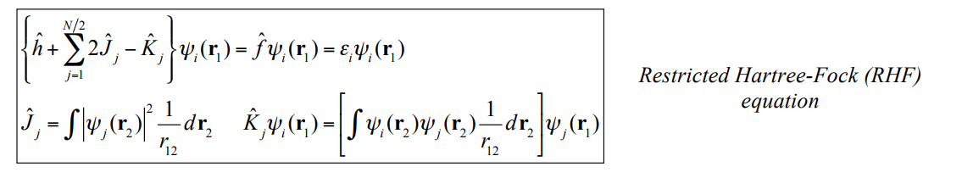
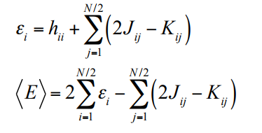
Many-electron wavefunctions
Hartree model: Include only classical Coulomb repulsion
Hartree-Fock model: Include Coulomb and exchange
Much better model than Hartree alone, but much harder to solve

Slide 3



Electron density
Electron density is the measure of the probability of an electron being present at a specific location
gives the total number of electrons within some volume element, and has the property
Can a theory be built just on this function? Yes!

Slide 4




Thomas-Fermi-Dirac model
Thomas (1926) and Fermi (1928) independently tried to construct a model for the atom based on its charge density ρ.
Approach: write down an expression for the energy in terms of kinetic and potential energy contributions, and appeal to variational principle to develop differential equation for ρ.
Problems: Homogeneous gas model for kinetic energy is a big error; Classical treatment of electron interactions (no exchange or correlation, and includes electron “self-interaction”).

Slide 5
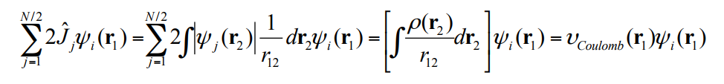
Hartree-Fock-Slater model
In 1951 Slater introduced an approximation that includes the density to the Hartree-Fock model
Coulomb repulsion of electron 1 with all electrons:

Slide 6

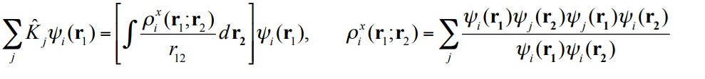
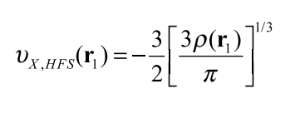
Hartree-Fock-Slater model
The exchange potential can be rewritten in terms of an exchange charge density:
Slater approximated the exchange potential in terms of the density, drawing on homogeneous gas model:

Slide 7
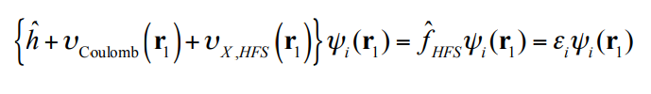
Hartree-Fock-Slater model
We can now write an approximate Hartree-Fock-Slater equation:
Left-hand side is the same for all electrons, and just involves the total electron density, ρ. Still has to be solved iteratively, using self-consistent field.
Much simpler than Hartree-Fock and better than Thomas-Fermi, and anticipated modern DFT.

Slide 8
Summary
Hartree model: Include only classical Coulomb repulsion
Hartree-Fock model: Include Coulomb and exchange
Hartree-Fock-Slater model: Include Coulomb and approximate expressions for exchange
Density-functional theory: Include Coulomb and approximate expressions for exchange and correlation

